Slide 1

This is the font to be used.
Font: Arial
Size: 12

Slide 2
User
Model
UI
Parser
Command
ModuleList
Storage
File
<_
Duke
Editor
Common
Console

Slide 3
Data directory
Module directory
Module .txt file
Cheat sheet directory
Cheat sheet .txt file

Slide 4
<<class>>
ModuleList
writeModule()
Writer()
Writer
writer: Writer
writeModule()

Slide 5
<<class>>
ModuleList
loadModuleCodes()
Loader()
Loader
getModules()
moduleCodes : ArrayList<String>
loop
[all module codes]
insertModule(moduleCode : String)

Slide 6
<<class>>
ModuleList
setSelectedModule(moduleCode : String)
Loader()
Loader
loadModule(moduleCode : String)
module : Module
opt
[module not null]
sortLessons()
sortTasks()
Writer()
Writer
writeModule()

Slide 7
sd create AddLessonCommand object
:Parser
AddLessonCommand(lesson: Lesson)
:AddLessonCommand
addLessonCommand: AddLessonCommand
command: Command

Slide 8
This is the font to be used.
Font: Arial
Size: 12

Slide 9
ModuleList
1
*
Module
<<enumeration>>
LessonType
1
1
1
*
*
Lesson
Task
1
0..1
TeachingStaff

Slide 10
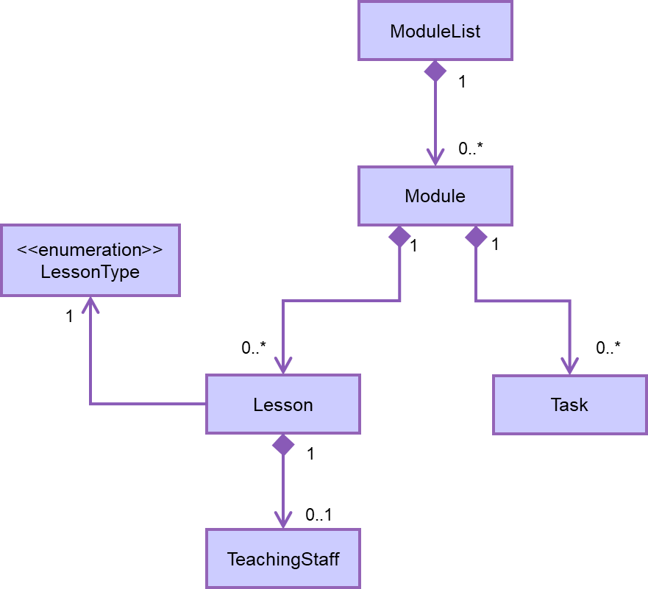

Slide 11


Slide 12
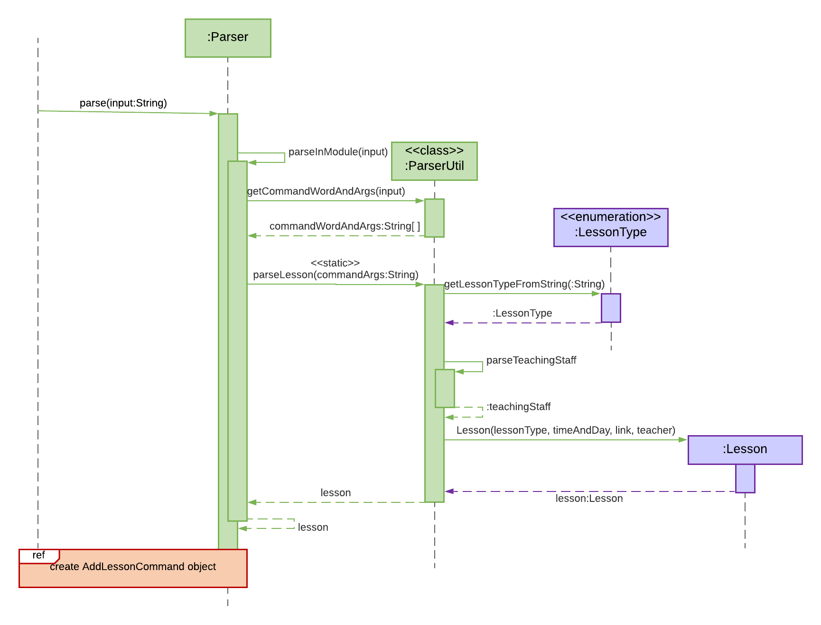
Done using

Slide 13
:Duke
:UI
:Parser
Loop
[Until exit command entered]
readCommand()
input:String
parse(input:String)
:Command
command:Command
:Command
execute(:UI)
printMessage(:String)
isExit()
isExit:boolean

Slide 14
Parser
UI
Command
Model
{abstract}
Command
+ execute() {abstract}
+ isExit(): boolean
Storage
XYZCommand = AddModuleCommand, etc.
XYZCommand

